Slide 1
Insights using MySQL to explore Global Trade Item Number (GTIN) data structures
Randy Lisbona, Marvin Scott, Vinh Le
SMU MSDS 7330
File Organization and Database Management
Section - 403
Dec 2016
Github Repository: https://github.com/rlisbona/MSDS-7330-Term-Paper-1

Slide 2
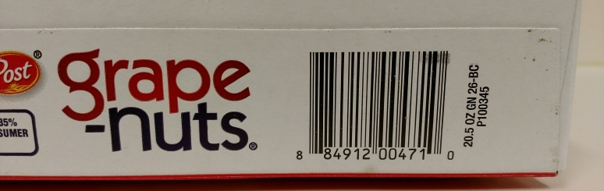
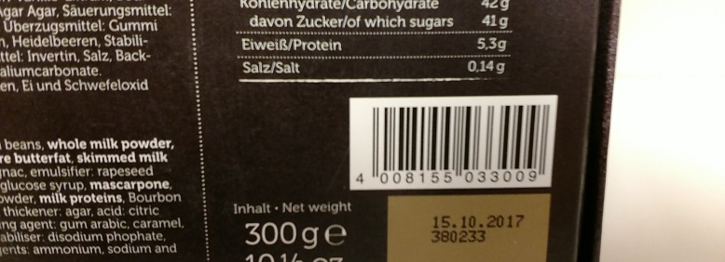

Global trade item numbers
“UPC-A” in north america
“EAN-13” in europe
General Format: -Optional Indicator prefix (packaging level)
-Unique Global Company Prefix (GCP)
-Company assigned item id
-Check digit
-Encoded in a machine readable “Data Carrier”
-Typically Linear barcodes, 2D matrix codes and RFID also supported
GCP numbers are assigned by GS1.ORG to ensure unique numbers globally. GCP does not define or maintain item id’s.
Notes:
GS1 does not maintain a worldwide list of Global Trade Item numbers (GTIN), GS1 simply assigns Global Company Code prefixes to ensure unique GTIN values. Each company using GTIN maintains their own list of item numbers and shares this with their trading partners. There are several initiatives to create a global open source GTIN list. For this project the Product Open Data (POD) database was used. This is far from a complete database in its current state, but does demonstrate the type of data linked to GTIN’s.

Slide 3
GS1 Numbering System
Numbering System Managed by GS1
Global Trade Item (GTIN)
Global Shipping Number (GLN)
Serial Shipping Container Code (SSCC)
Global Returnable Asset Identifier (GRAI)
Global Individual Asset Identifier (GIAI)
Global Service Relation Number (GSRN)
Global Document Type Identifier (GDTI)
Global Shipment Identification Number (GSIN)
Global Item Number for Consignment (GINC)
Global Coupon Number (GCN)
Component / Part Identifier (CPID)
Notes:
GTIN(Global Trade Item Number is just one of the numbering systems managed by GS1.

Slide 4
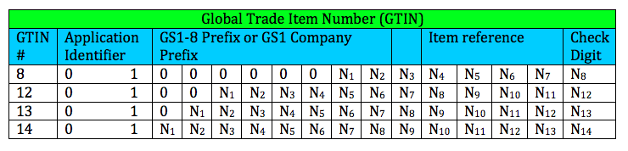
GTIN Numbering System
Notes:
Global Trade Item Number( GTIN) is a number that uniquely identifies trade items as they move through the global supply chain. It is a well-established standard for every country around the world for trade items. Uniqueness and data quality are two key attributes of a GTIN number that ensure all trade items are identify correctly anywhere in the world. There are rules in assigning each number with a standardized format and structure to ensure that every variation of an item is allocated a single number that is globally unique. GTIN simplifies supply chain management and provides accuracy, speed, and efficiency for business.
From this chart you can see that A GTIN consists of four parts, an optional Application Identifier, the Company Prefix, the Item Reference, and a check digit. Notice that price is not in the GTIN, the GTIN is used to lookup product price in an external database.
GTIN-8 is a truncated 8 digit GSI identification key used on packages with limited label space, such as chewing gum.
GTIN-12 is 12 digit GSI identification key consisting of a U.P.C. company prefix, item reference, and check digit.
GTIN-13 is a 13 digit GSI identification key consisting of a GS1 Company prefix, item reference, and check digit
GTIN-14 is a 14 digit GSI identification key consisting of an indicator digit (1-9), GS1 company prefix, item key, and check digit.

Slide 5
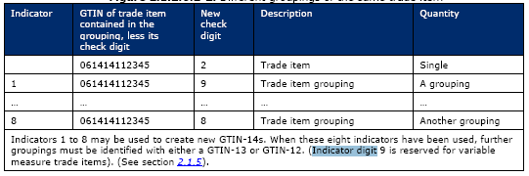
GTIN Numbering System
Figure 2 - Indicators
Notes:
The Indicator Prefix Digit is used to define a grouping, or packaging level. For instance, in Figure 2, [1] we see an example GTIN of 061414112345, let’s say this was a 2oz bag of candy corn. Adding an indicator prefix of “1” could denote a bulk pack of 12 2oz packages, indicator prefix “2” could be used for a 24 pack, indicator prefix “3” could be a “Gross” pack (144) of 2oz candy corn packages, and so on. If more than 8 packaging levels are needed, then a new GTIN-12 or GTIN-13 is required.
Indicator prefix “9” is reserved for variable measure trade items. Variable measure items are trade items that cannot guarantee consistent weight, size, or length due to the production process (e.g. meat, bulk cheese).

Slide 6
GLN Numbering System
Benefits of GLN
Provides companies with a method of identifying location within and outside their company
Unique
Multi sectoral
International
Notes:
Global Location Number (GLN) is a type of GS1 identification key used to determine any location that needs to be identified in the supply chain. It is designed to efficiently identify physical locations, Operational locations, and Party. GLN are used for retrieving information from different entities such as hospitals, medical supplies, delivery point, warehouses, and banks. It is constructed with a13-digit numeric structure with a prefix, location reference, and check digit. GS1 Company Prefix is assigned by a GS1 Member Organization a user. Location reference is allocated by the company to a specific location. Check digit is calculated according to a standard algorithm, which helps to ensure integrity. GLNs provides companies with a method of identifying location within and outside their company to prevent duplication, complexity, and significance problems. The benefit of using GLNs is that it is unique, multi sectoral, and international.
A Global Location Number provides a unique and unambiguous identification of physical locations and parties used in the supply chain or participating in a business process.

Slide 7
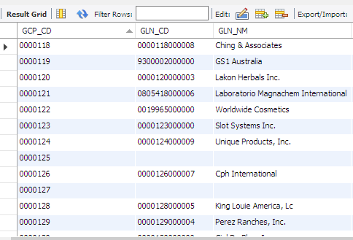
GLN Numbering System – Company Names
Table gs1_gcp contains Global Location codes and associated company names
Exploratory queries shows missing entries and unusual company names
A summary query showed only about 1/3 of the records had valid company names
Notes:
Global Location Number (GLN) is a type of GS1 identification key used to determine any location that needs to be identified in the supply chain. It is designed to efficiently identify physical locations, Operational locations, and Party. GLN are used for retrieving information from different entities such as hospitals, medical supplies, delivery point, warehouses, and banks. It is constructed with a13-digit numeric structure with a prefix, location reference, and check digit. GS1 Company Prefix is assigned by a GS1 Member Organization a user. Location reference is allocated by the company to a specific location. Check digit is calculated according to a standard algorithm, which helps to ensure integrity. GLNs provides companies with a method of identifying location within and outside their company to prevent duplication, complexity, and significance problems. The benefit of using GLNs is that it is unique, multi sectoral, and international.
A Global Location Number provides a unique and unambiguous identification of physical locations and parties used in the supply chain or participating in a business process.

Slide 8
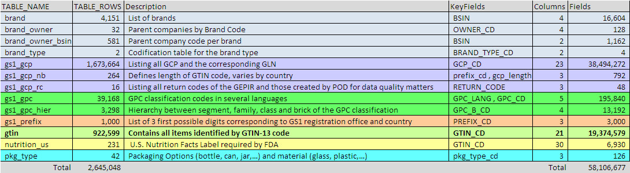
Product Open Data Install on local mysql server
Data Source: Product Open Data Subset of Global Trade Item numbers and related data http://www.product-open-data.com/download/
Download File : pod_web_2014.01.01_01.sql.gz
(58 KB zipped, 432 KB native file size)
Unzip and open/run in mySQL Community Workbench
Record counts and keyfields
13 tables, 2.6 M rows, 58M fields
Notes:
An open source GTIN subset > 100K records will be downloaded and installed on a local mySQL database instance. Open source documentation will be reviewed to better understand the GTIN data. A graphical schema of the database will be created with example data from each table to visualize the relationship between tables. Exploratory queries will be created to summarize selected fields such as brand, and packaging level. A summary list of mySQL commands used in the analysis will be provided along with impressions on ease of use, intuitiveness, and effectiveness.
Thirteen tables containing 2.6 million rows were found in the POD database (see figure 6). Example records were extracted from each table and key fields were examined to generate a schema. See Appendix B, Figure B1. Discrepancies from the schema in the specification file found with the POD database were resolved using key field names and matching records in the POD database. While there were at least a few records in each table, matching records in related tables proved to be disappointing. See Appendix C, figure C1 for a summary of matching records in the 7 largest tables. Of the 2.6 million original rows, only 52 were linked between 6 tables, 0 for 7 or more tables. The website seems to imply POD is an attempt at a global GTIN registry but it appears it may have been abandoned in early 2014, the last revision date on the database dump.

Slide 9
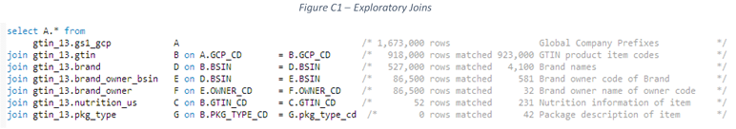
Exploratory steps
Exploratory mysql sourcecode: https://github.com/rlisbona/MSDS-7330-Term-Paper-1/blob/master/Explore/Explore%20gtin_13.sql
Contains example Queries to:
Count records in each table
Determine primary keys
Check for secondary indexes (none found)
Extract example records from each table
Count matching records between related tables
Queries for summary charts in the term paper
Initial exploratory queries appeared to show a lot of useful data
But linked queries showed as we added more tables,
we had fewer and fewer matching records

Slide 10
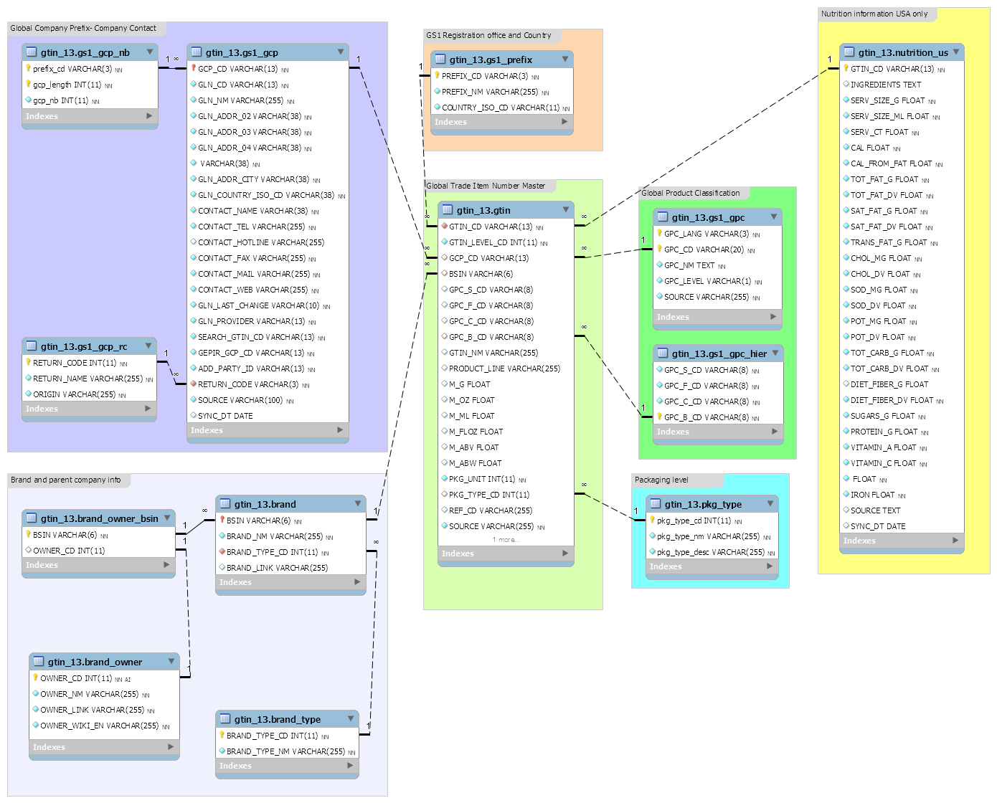
Product Open Database Schema
GS1 Registration Country
Brand and company contact details
Nutrition
Global Product Class Type
GTIN
(Unique Item ID)
Packaging
Parent Company
GTIN_CD = Global Trade Item Number
BSIN = Brand Standard Identifier Number
GCP_CD = Global Company Prefix code

Slide 11
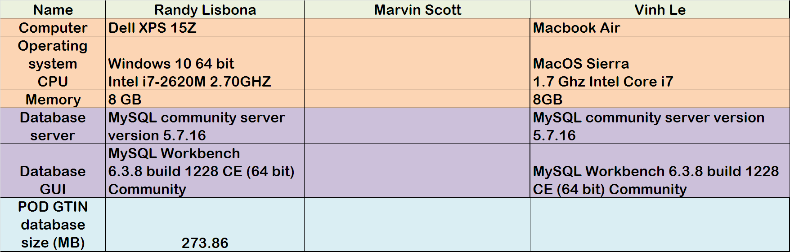
Host PC, operating system and Database details used for the project

Slide 12
GTIN/POD Summary
GS1.ORG is a global standards organization for global trade item indentification
Global Trade Item Number (GTIN) is one of 11 numbering systems maintained by GS1
GS1 does not maintain or publish the GTIN detail records
Each company shares GTIN and related information with trading partners
Product Open Database (POD) is one of several attempts at creating a global list of GTIN codes.
POD does not show any updates after 1/1/2014, so appears to be abandoned.
MySQL was used in this project to explore and learn about GTIN and POD data.
Notes:
Without Global Company Prefixes and Global Trade item numbers, it would be possible and highly likely that different companies could choose to use the same identification number (Part number) on their products. It is hard to imagine how global trade would work without Global Trade Item Numbers and the GS1 organization in place to ensure a unique numbering system worldwide. GS1 does not maintain a list of global trade item numbers, they just maintain the Global Company Prefixes used to ensure unique item numbers. The Product Open Database (POD) gave an interesting peak into the detailed data related to GTIN, but it’s small size and fractured nature were disappointing.
There are several other “Open” implementations of Global Trade Item numbers. See Appendix A, table A2. POD first appeared to be a complete subset but after further investigation it was found to be missing enough linked records in related tables to be very useful.

